Slide 1
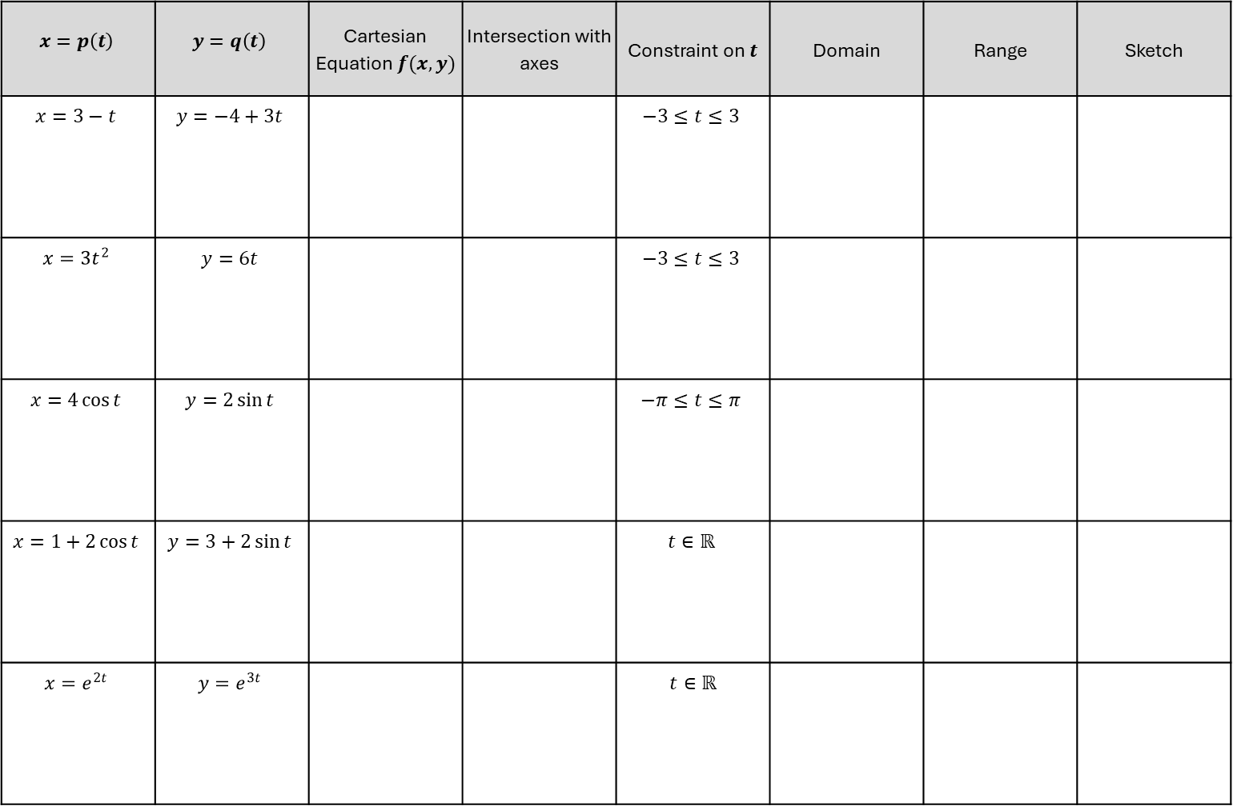
$$x=p\left(t\right)$$ | $$y=q\left(t\right)$$ | Cartesian Equation $f(x,y)$ | Intersection with axes | Constraint on $t$ | Domain | Range | Sketch
$$x=3−t$$ | $$y=−4+3t$$ |  |  | $$−3≤t≤3$$
$$x=3t^{2}$$ | $$y=6t$$ |  |  | $$−3≤t≤3$$
$$x=4\cos{t}$$ | $$y=2\sin{t}$$ |  |  | $$−π≤t≤π$$
$$x=1+2\cos{t}$$ | $$y=3+2\sin{t}$$ |  |  | $t∈ℝ$
$$x=e^{2t}$$ | $$y=e^{3t}$$ |  |  | $t∈ℝ$

Slide 2
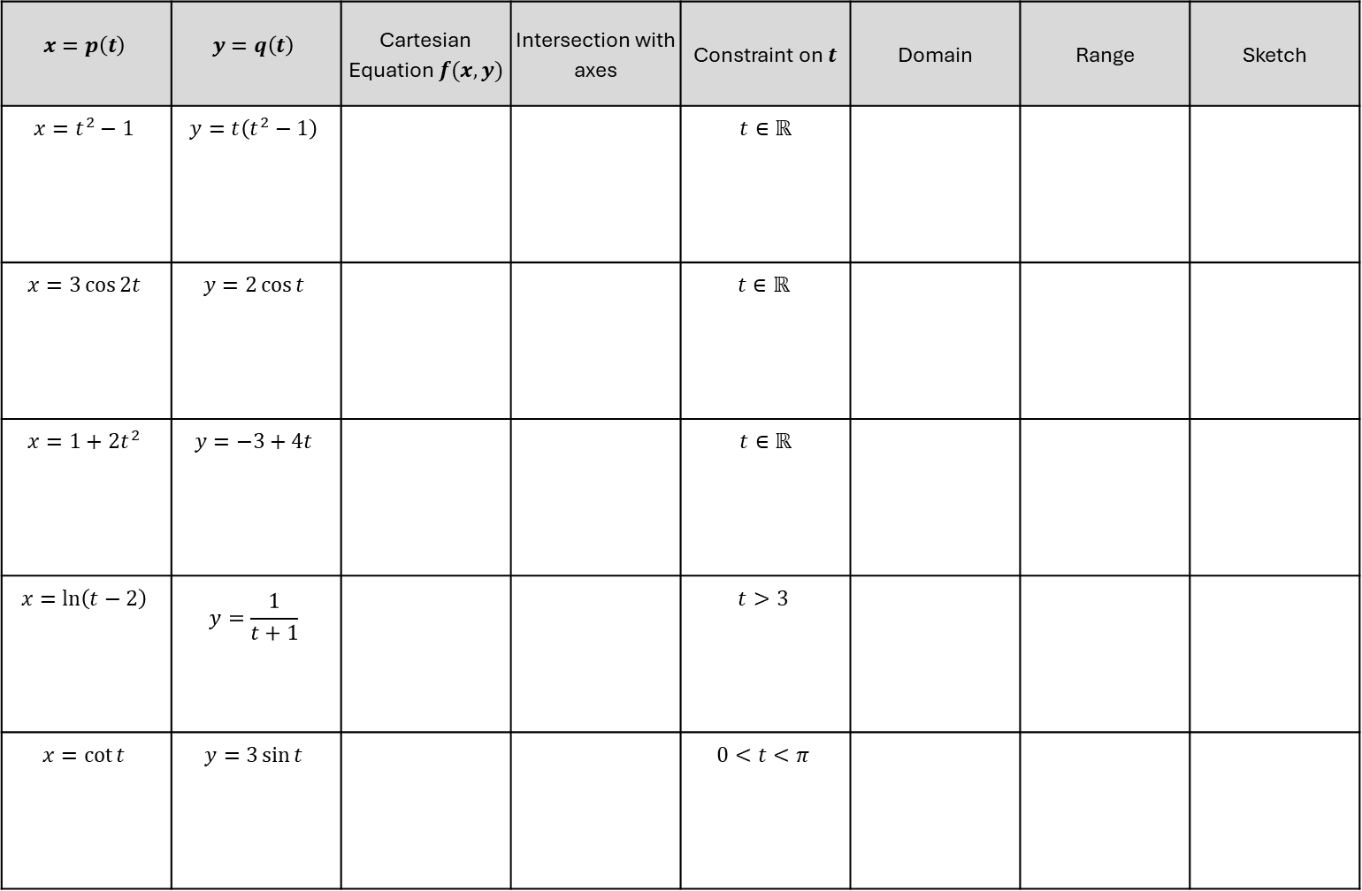
$$x=p\left(t\right)$$ | $$y=q\left(t\right)$$ | Cartesian Equation $f(x,y)$ | Intersection with axes | Constraint on $t$ | Domain | Range | Sketch
$$x=t^{2}−1$$ | $$y=t\left(t^{2}−1\right)$$ |  |  | $t∈ℝ$
$$x=3\cos{2t}$$ | $$y=2\cos{t}$$ |  |  | $t∈ℝ$
$$x=1+2t^{2}$$ | $$y=−3+4t$$ |  |  | $t∈ℝ$
$$x=\ln\left(t−2\right)$$ | $$y=\frac{1}{t+1}$$ |  |  | $$t>3$$
$$x=\cot{t}$$ | $$y=3\sin{t}$$ |  |  | $$0<t<π$$

Slide 3
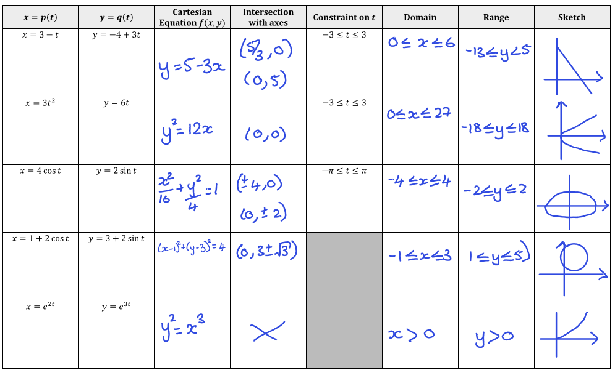

Slide 4
